Slide 1

SARTHANA – Reimagining UPSC Civil Services Preparation
A smart, personalized, and gamified learning app for UPSC aspirants.
Team: 37
By Tech T-Rex

Slide 2
Team Information
Team Lead: U. Sai Hruvthin
Team Members:
1. Wagmare Sanjana
2. Bobbili Ruchilasya
3. Rangdal Pavansai
4. Bollapally Manish Kumar

Slide 3
Problem Statement
Most UPSC preparation apps offer generic content without addressing the personalized needs of aspirants. They lack smart revision tools, engaging formats, and features like interactive current affairs, answer writing feedback, or AI-driven learning paths. This leads to poor retention, low motivation, and ineffective preparation. Aspirants, especially from Tier 2 and Tier 3 cities, struggle with information overload and no structured guidance. There's a clear need for a more adaptive, accessible, and engaging solution that not only delivers content but also guides, evaluates, and motivates aspirants throughout their preparation journey.

Slide 4

Challenges in Current UPSC Prep Apps
One-size-fits-all Approach
Boring User Experience
Lack of customization for individual learning needs
Text-heavy, lacks engagement and visual appeal
Poor Integration
Current affairs and answer writing not woven well

Slide 5

Our Vision for UPSC Preparation
Smart Learning
Community
Adaptive, AI-driven content tailored to each aspirant
Collaborative learning with the support and peers
With other aspirants
Engagement
Gamification to boost motivation and consistency

Slide 6
Features of Sarthana
Real-time performance dashboards
Bookmarking and revision tracking
Subject and topic-wise quizzes
Daily current affairs with revision mode
Previous Year Questions (PYQs) & mock tests

Slide 7






Unique Features That Set Sarthana Apart
AI Study Path
multilanguage support
Day-to-Day Updates
AI Feedback on Answer Writing
Gamification: XP, badges, streaks

Slide 8

Target Audience
Age 18-35
Early career and fresh graduates
Tier 2 & 3 Cities
Focusing on untapped markets in India
multilingual
all medium users supported through the chat bot
First-timers & Repeaters
Customized paths for varied preparation stages

Slide 9
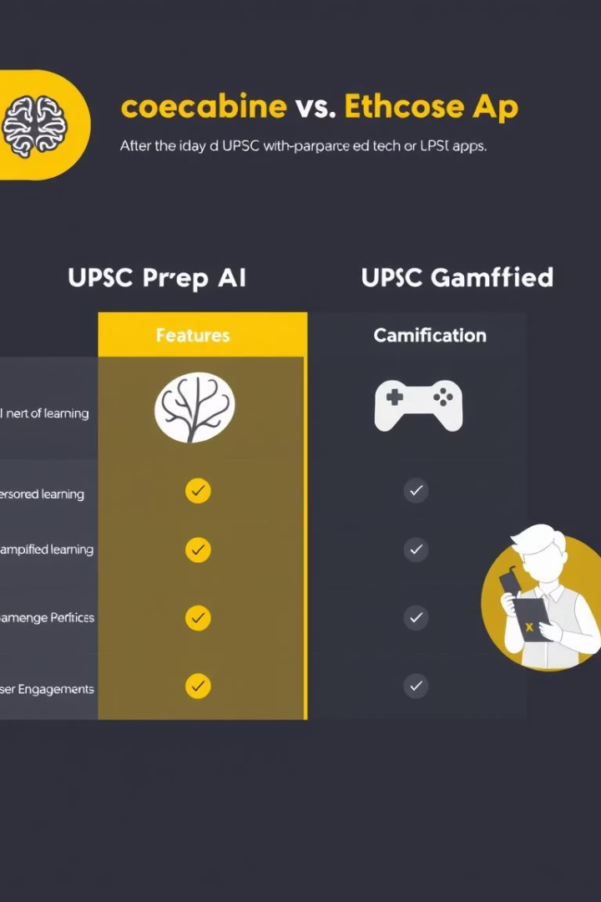
Competitive Analysis
Feature
Sarthana
Other Apps
AI Personalization
✅
❌
Gamification
✅
⚠️ Limited
Community Collaboration
✅
❌
Multilingual Support
✅
⚠️ Partial

Slide 10
Robust Tech Stack & Architecture
Frontend
NLP Engine
React Native for cross-platform apps
Automated answer and current affairs analysis
Backend
Database
superbase & Python AI modules
Firestore or PostgreSQL for scalable storage
AI
Personalization & dynamic question generation

Slide 11

Next Steps & Investment Opportunity
1
Finalize MVP Development
Launch beta within 3 months
2
Expand User Base
Target tier 2/3 cities aggressively
3
Scale AI & Gamification
Enhance adaptive learning capabilities
4
Secure Funding
Accelerate growth and market penetration

Slide 12
Call of Action:
Sarthana is more than just an app; it is a personalized learning companion, and we seek mentorship and support to turn this vision into reality and empower the next generation of civil servants.

Slide 13


